Slide 1
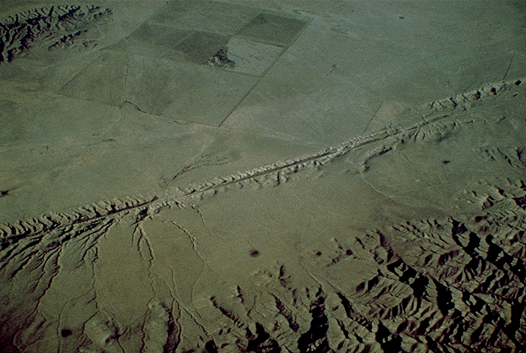
EARTHQUAKES:
WHY? AND HOW?

Slide 2
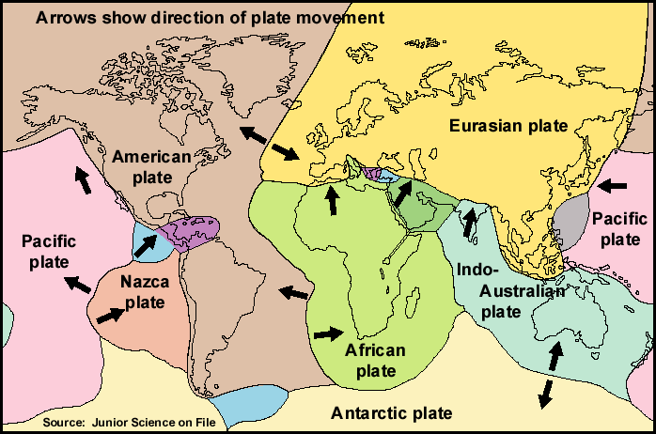
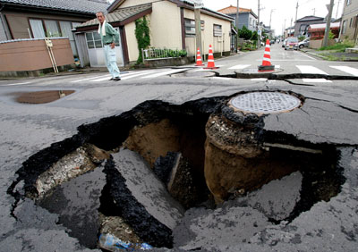
EARTHQUAKES
sudden movement or shaking of the Earth
Caused by plate tectonic stresses
Located at plate boundaries
Resulting in breakage of the Earth’s brittle crust

Slide 3
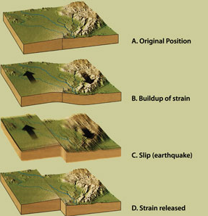
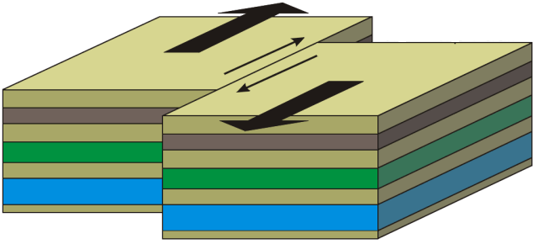
PLATE TECTONIC STRESSES
Plate boundaries and faults (= cracks where plate sections are moving in different directions) cause friction as plates move
Plates in a fault zone have STICK-SLIP motion
  Periods of no movement (stick)
  and fast movement (slip)
  Energy stored as plates stick,
  Energy released as plates slip

Slide 4
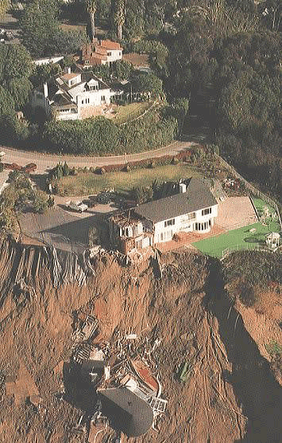
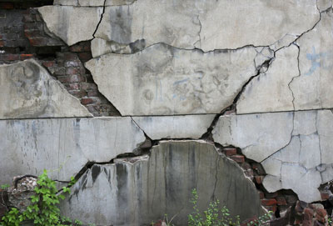
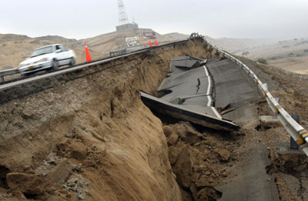
EARTHQUAKE DAMAGE
Landsides
Building damage
Liquefaction

Slide 5
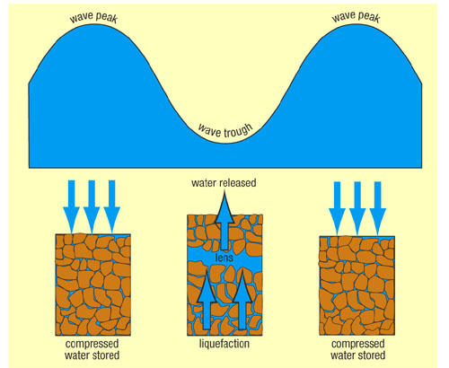
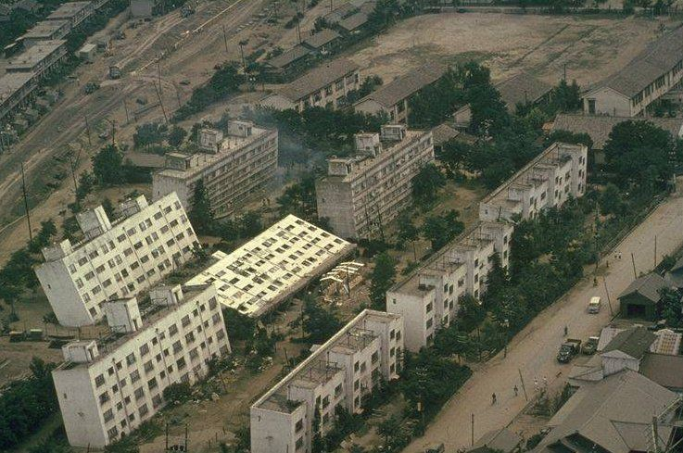
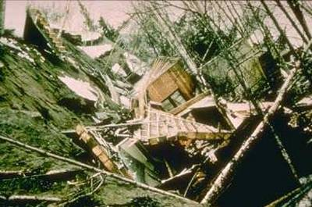
LIQUEFACTION
when a solid (sand and soil) becomes saturated with water and acts like a heavy liquid
Results in a loss of soil strength & the ability of the soil to support weight

Slide 6
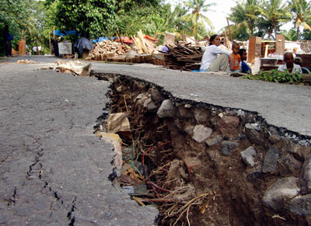
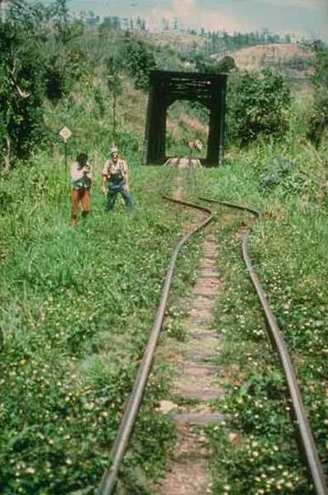
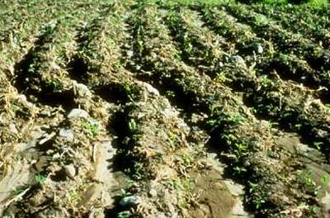
EARTHQUAKE DAMAGE
Most caused by SURFACE waves (arrive last)

Slide 7
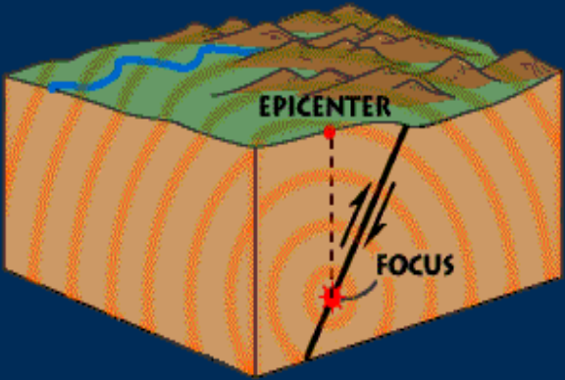
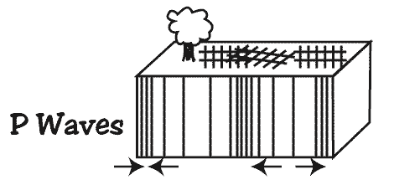
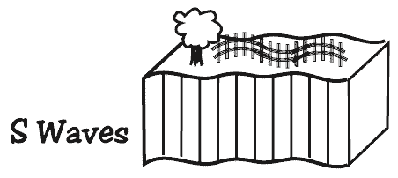
EARTHQUAKE WAVES
FOCUS = place deep within the Earth and along the fault where rupture occurs
EPICENTER = geographic point
on surface directly above focus
SEISMIC WAVES produced by the release of energy
  move out in circles from the point of rupture (focus)
  2 types: surface & body (travel inside & through earth’s layers)
    P waves: back and forth movement of rock; travel thru solid, liquid, gas
    S waves: sideways movement of rock; travel thru solids only
Notes:
http://earthquake.usgs.gov/learning/animations/

Slide 8
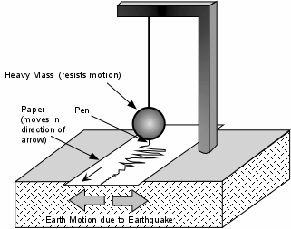
EARTHQUAKE WAVES
Seismographs record earthquake waves
Seismograms show:
Amplitude of seismic waves (how much rock moves or vibrates)
Distance to the epicenter
Earthquake direction
Notes:
Surface waves move along surface – not felt opposite side of earth

Slide 9
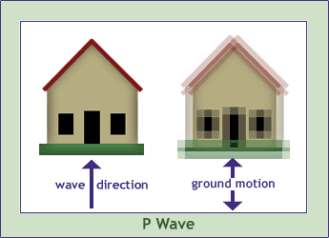
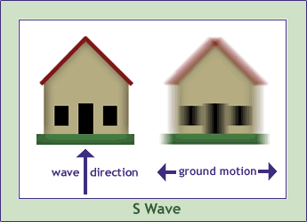
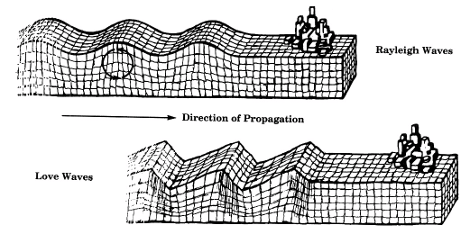
EARTHQUAKE WAVES
3 types of seismic waves show up on seismogram
  P waves: shake earth in same direction as wave;
  travel thru solid, liquid, gas
  S waves: Shake earth sideways to wave direction;
  travel thru solids only
  Surface waves: circular movement of rock;
  travel on surface – cause most damage!!
Notes:
Notes: Surface waves cause most damage (“L” waves – feel like ocean waves)
Body waves move through the earth
p & s are Body waves – move through the earth
http://earthquake.usgs.gov/learning/animations/

Slide 10
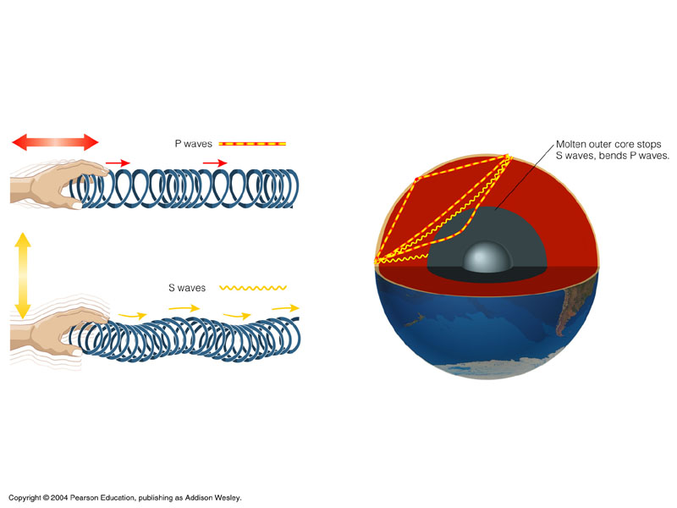
EARTHQUAKE WAVES
P waves move through solids & liquids
S waves move through solids only!!!
Notes:
Notes: Surface waves cause most damage (“L” waves – feel like ocean waves)
Body waves move through the earth
p & s are Body waves – move through the earth
http://earthquake.usgs.gov/learning/animations/

Slide 11
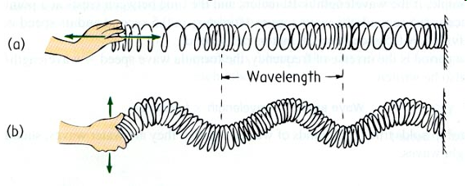
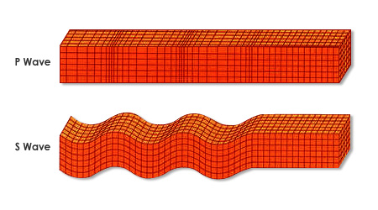
EARTHQUAKE WAVES
Body | P waves | S waves
waves
AKA
Moves through
Movement of rock
Primary (1st to arrive)
Longitudinal, Compression
Secondary (2nd to arrive - larger)
Transverse, Shear
all states of matter
(solid, liquid, gas)
Can go through solids only
back and forth movement of rock
push/pull or compression/stretch out
Like slinky down stairs
Vibration is same as the direction of travel
Move sideways
perpendicular to direction of wave travel
Like snake
Notes:
Surface waves cause most damage (“L” waves – feel like ocean waves)
Body waves move through the earth
Surface waves move along surface – not felt opposite side of earth

Slide 12
EARTHQUAKE MAGNITUDE
measures the size of seismic waves →
the energy released by the earthquake
Richter scale=measurement of energy released based upon wave amplitude (size of vibration)
<2 to ~10
What you need:
Amplitude (size of vibration = wave height)
Time between arrival of 1st P and 1st S waves

Slide 13
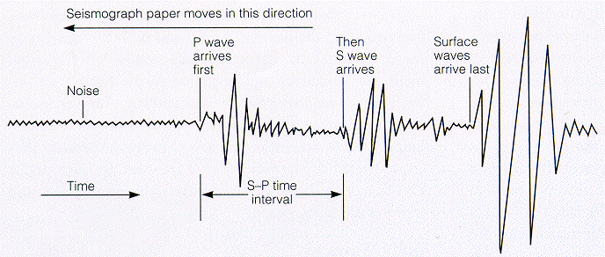
HOW TO READ SEISMOGRAMS
P & S (body waves) move through earth & arrive first
P & S waves used to calculate magnitude of earthquake
Amplitude = height of wave (how much the rock moves; size of vibration)
Notes:
GOOD ANIMATION: http://www.wwnorton.com/college/geo/egeo/flash/8_3.swf
Introduce AMPLITUDE = height of wave

